Slide 1
An Introduction to HL7® FHIR®
Lloyd McKenzie

Slide 2


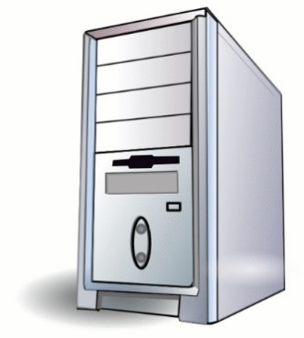
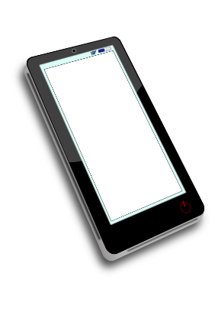
What is FHIR?
Standard to share healthcare data
Why?
Better patient care
More efficient delivery
How?
The right data
to those who need it
when they need it
wherever it’s from

Slide 3
What makes a “successful” standard?
Well-Defined
What data?
What meaning?
How shared?
Cheap,
Easy
Widely Implemented
Used Consistently
Same problem = same solution

Slide 4


A word of caution

Slide 5
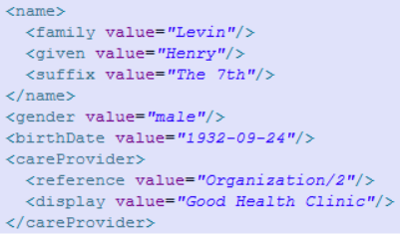
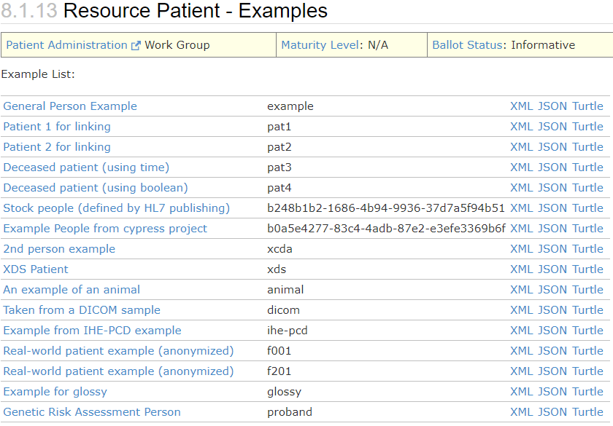
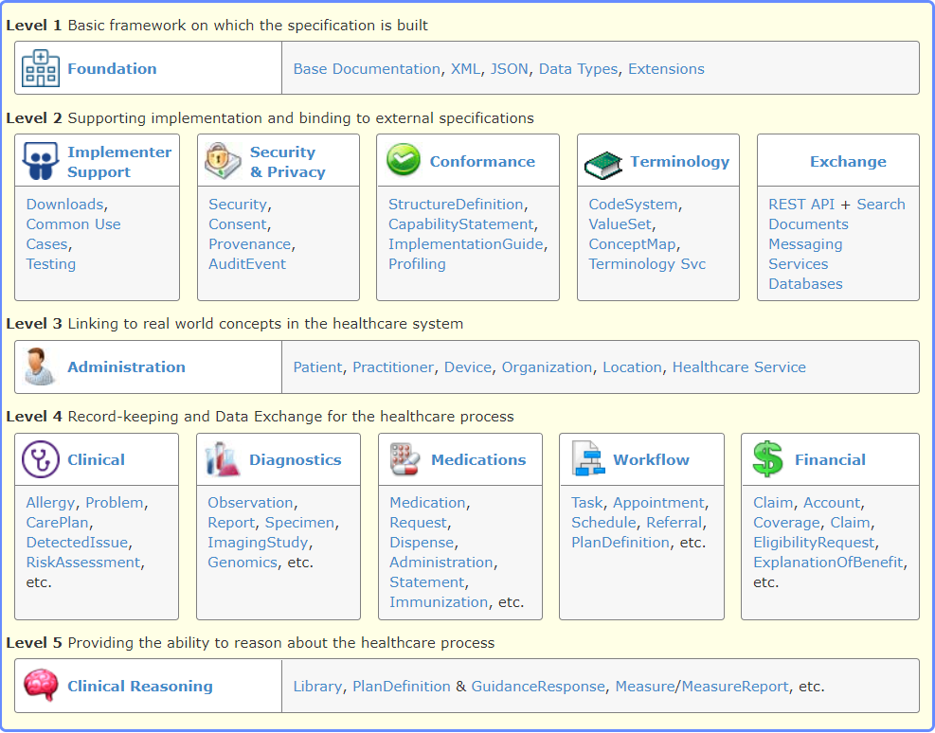
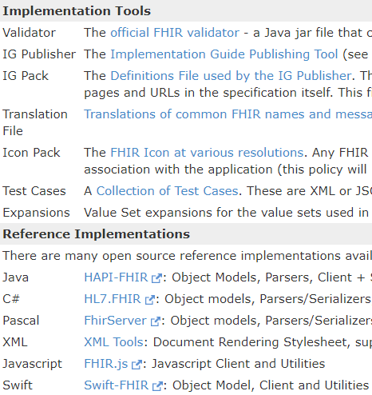
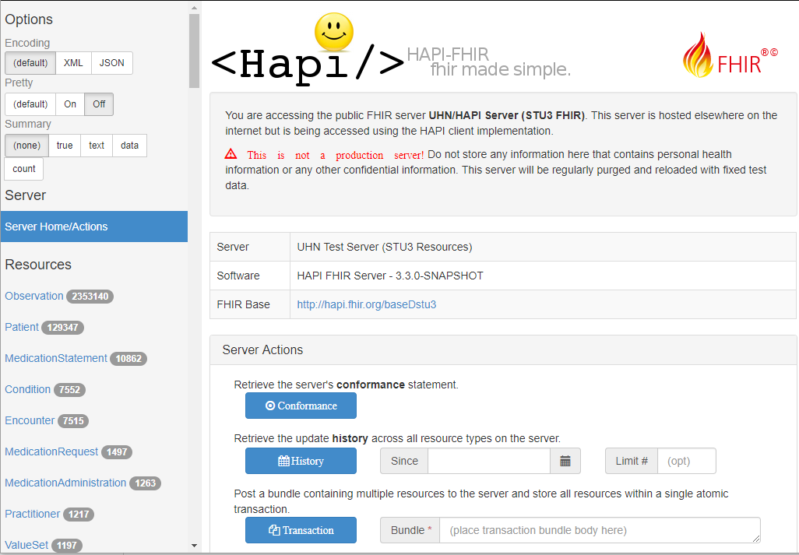
1. Focus on implementers

Slide 6

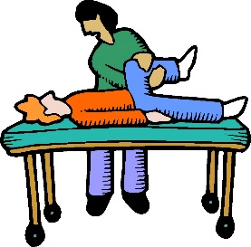





2. Simple, with extensibility
Healthcare

Slide 7




2. Simple, with extensibility
Healthcare
FHIR
(core)

Slide 8
2. Simple, with extensibility
Extensions & Profiles are:
Resolvable
Sharable
Discoverable
Testable
Result
Easy to understand
Can do complex things
Systems can evolve & still interoperate
FHIR
(core)

Slide 9
Example
isNotOrdered, updateMode, flavorId, nullFlavor, controlAct root & extension, validTime low and high, useable period (GTS – no room on the slide), use:
home, primary home, vacation home, workplace, direct, public, bad, physical, postal, temporary, alphabetic, ideographic, syllabic, search, soundex, phonetic
0..* parts, each with:
value, code, code system, code system name, code system version, language, type:
address line, additional locator, unit identifier, unit designator, delivery address line, delivery installation type, delivery installation area, delivery installation qualifier, delivery mode, delivery mode identifier, street address line, building number, building number numeric, building number suffix, street name, street name base, street type, direction, intersection, care of, census tract, country, county or parish, municipality, delimiter, post box, precinct, state or province, postal code, delivery point identifier
Notes:
How many of your systems have user interfaces that support even ¼ of this?

Slide 10
Example
isNotOrdered, updateMode, flavorId, nullFlavor, controlAct root & extension, validTime low and high, useable period (start, end) (GTS – no room on the slide), use:
home, primary home, vacation home, workplace, direct, public, bad, physical, postal, temporary, alphabetic, ideographic, syllabic, search, soundex, phonetic, old
0..* parts, each with: text
value, code, code system, code system name, code system version, language, type:
address line, additional locator, unit identifier, unit designator, delivery address line, delivery installation type, delivery installation area, delivery installation qualifier, delivery mode, delivery mode identifier, street address line, building number, building number numeric, building number suffix, street name, street name base, street type, direction, intersection, care of, census tract, country, county or parish, municipality city, delimiter, post box, precinct, state or province, postal code, delivery point identifier
Notes:
How many of your systems have user interfaces that support even ¼ of this?

Slide 11



3. Modern technology
Use HTTP stack
API, security informed by:
Syntax
XML, JSON, RDF
FHIR is web-based and free
Result:
Easy to find people / build skills
No expensive consultants
Lots of (free) tools
Built-in support in most languages
I.e. cheaper / faster / easier

Slide 12
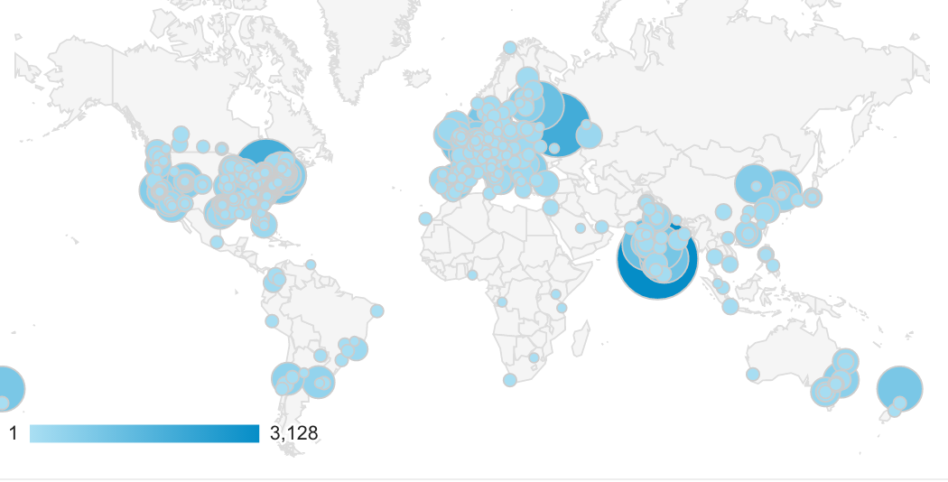
4. Community

Slide 13

4. Community
Guidance & support
http://chat.fhir.org
Connectathons
Tools
Consensus

Slide 14
Summary
Standard to share healthcare data
Enables improved adoption & consistent implementation
Designed for implementers
Simple but extensible
Modern technology
Strong community
Enables better & more efficient healthcare

Slide 15



Lloyd McKenzie
Slides: http://bit.ly/fhirintro
lmckenzie@gevityinc.com

